Slide 1


[Title]

Slide 2


Today's agenda
Project recap
Problem
The Analytics team
Process
Insights
Summary

Slide 3

Social Buzz, founded in 2010 by two former engineers.
200 technical, 50 nontechnical staff.
High scale success in short term.
Currently undergoing its Initial Public Offering process.
Project Recap

Slide 4


Problem
Top 5 Popular Categories
IPO Recommendations

Slide 5
Andrew Fleming
Chief Technical Architect
The Analytics team
Marcus Rompton
Senior Principle
Dana Diab
Data Analyst

Slide 6
Process
1
Data Understanding
2
Data Cleaning
3
Data Modelling
4
Data Analysis
5
Uncover Insights

Slide 7

Insights

Slide 8
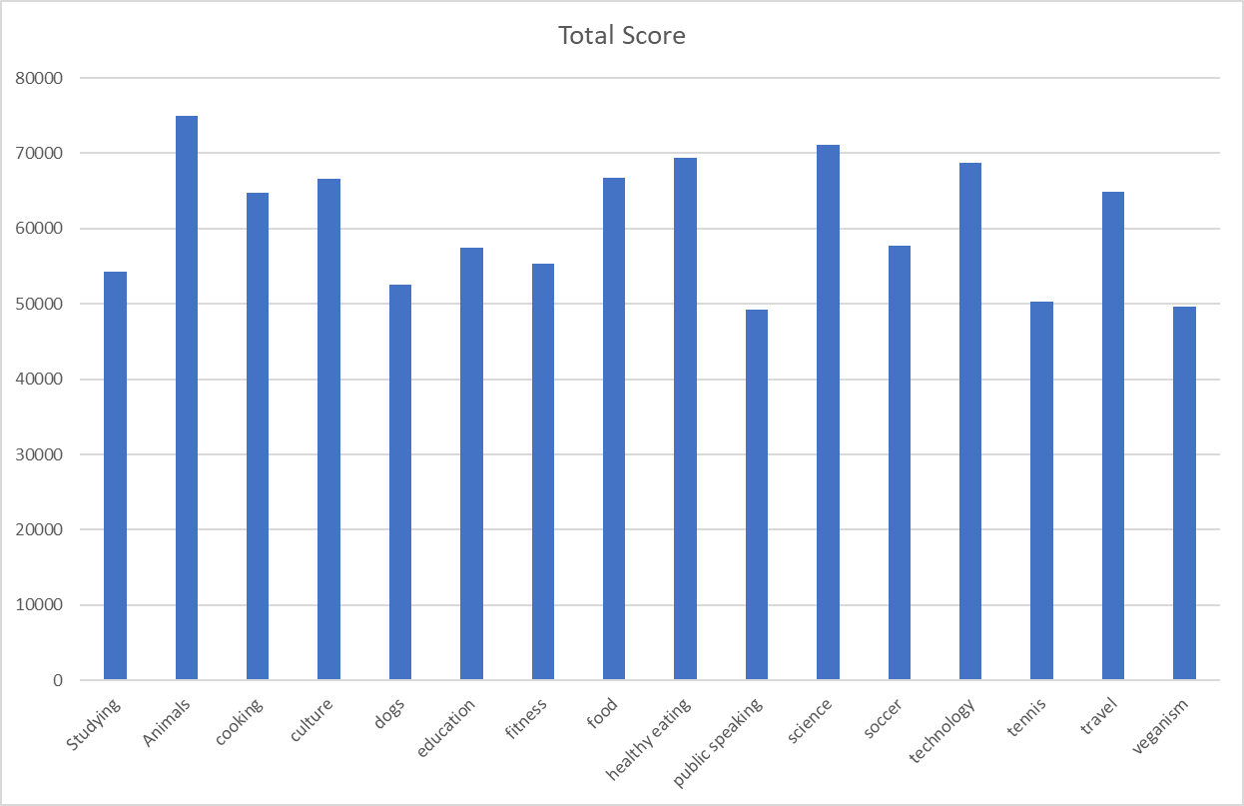
Top 5 Popular Categories.
All Unique Categories.
Total Number of Reactions of The Most Popular Category.

Slide 9
Most posts are made in May.

Slide 10

In Conclusion, our analysis revealed that the top five most popular categories are Animals, Science, Healthy Eating, Technology, and Food. Additionally, after thoroughly cleaning, analyzing, and visualizing the data, we found that the highest number of posts occur in May.
Summary

Slide 11

Thank you!
ANY QUESTIONS?

